Slide 1
May RELEASE CYCLE
2017
Change Request/Incidents

Slide 2
Some common Terms:
Scope Sheet
SharePoint
CR /INC - Data or Cross
Unit Test Script
User/Integration Test Script
Data Issue Log (OLAP and OLTP)
SVN Update
Release Deliverables – HLFD, HLTD
Links for: SharePoint, JTI Deliverables, Incidents, Defects, DTD
Service Now
Notes:
Show them where to find templates
Explain the different terms

Slide 3
Change Request/Incidents Life Cycle
As described below, the following stages must be adhered when working on
change requests and incidents. The stages are:
Analysis (MRU Side)
Business Approval (ODC Side)
Development & Testing (MRU Side)
Review Process (MRU Side)
Ready in DEV
Note: We have two types of CR/Incidents:
Data : Only the data team is impacted
Cross: All 3 teams or 2 teams may be impacted (Sales, Data and OBIEE)
Notes:
Explain the life cycle of CR/INCS. Afterwards we have defects and incidents
What happens when CR/INCS is cross or data. What documents are used?

Slide 4
Step 1: Analysis
The analysis can be done at:
High level
A high level information on the changes that should be done as per FD (Functional details provided).
Detailed level
All impacted mapping and detailed information on the changes that should be done
are provided. All these details are provided in a DTD (Detailed Technical
Design) which is sent to ODC for validation and approval.
Note:
1.The DTD document is versioned. Each time a FD provided, we
have to create a new version of the DTD and update SharePoint with a comment.
2. We have to provide the effort estimated to implement CR. Normally the approximate
Man days are:
Examples:
1 ETL: 0.65
1 Loader: 0.85
DTD should be peer reviewed and uploaded to sharepoint.
3. Sharepoint Update:
Data Development Status = Estimates Ready
MRU Effort Estimated = Total Effort Estimated as per DTD
Data Assigned Person = ODC Siebel (Miguel or Jaime)
Upload Release Deliverables documents impacted for validation
Notes:
Show where document templates are kept
Show examples of different DTD versions

Slide 5
Step 2: Business Approval
Once we have estimated the effort with the DTD, we assign change request
or incident to ODC to validate. During this process, we may have to re-adjust
DTD and effort estimated based on feedback from ODC.
Some Scenarios are:
ODC does not approve total effort estimated (over-estimated)
Some new requirements due to change in FD
Some unforeseen requirement linked to other CR
Finally, when ODC approves DTD provided for CR or Incident, it is assigned
back to MRU. In addition, during analysis phase we may request for additional
information from ODC if FD is unclear and when we assigned CR to ODC, we set
status to “More Information Needed”

Slide 6
Step 3: Development Phase
Change Request assigned back to MRU in development phase:
When starting the development, the developer must update Data Scope Sheet and SharePoint:
Sharepoint: Data Development Status = In Progress
Scope Sheet: MRU Development Status = In Progress on CHG Data Scope Tab
Add retrofit entry in AM Retrofit Log Tab and set status to Not Started; if retrofit not required, set status to Not Applicable
Effort Burnt should be updated at the end of each day –If overburn, send mail to Jaime/Miguel and Robert\Hursha with details
Secondly, the approved DTD must be used and there are specific guidelines that
should be followed as per guideline document:
https://mruperf/svn/svn_repos/Phase II/General/03 - Documents/05 - Data Team Standard Procedures/TME Phase 2 - Data Development Guidelines v1.6.pdf
Finally, the developer must ensure that:
Developer should go through FD once again so that not to miss out functionalities(that may have been omitted during Analysis Phase)
A folder for the CR/INC is available in release folder bearing the name of the CR/INC.
Place the unit test script (for FF Load, add flat file generator) in the “03-Build Folder” inside the impacted change request/Incident
Commit the stored procedures on SVN, IFB files or any associated documents. (refer to guidelines for convention used). Also, inform Techarch Team for any New folder created on SVN in Server Scripts folder.
Add comments to workflows, mappings or any impacted documents to keep track of modifications.
Data Issue log should be updated
Data Impacted Objects should be updated – Add Generic Interfaces*
Data Update Template or Post Task should be prepared
Save effort- OLTP :Import\Export XML
OLAP:Import\Export XML for NEW mapping only.
Notes:
In case CR is estimated for more than 1 man days, the field Effort Consumed must be updated on a daily basis with the current effort consumed so far.
HLFD , DD for ETL DEV

Slide 7
Generic Interfaces*
Generic Interface Development:
Decommission existing interface –Mapping and Worklet
Create Generic mapping and Worklet
Fill Data Impacted Tab for new generic OLTP/OLAP Interface
Ensure Java Table population
Ensure entity is added to Ini Files(pre-ADHOC_OLTP.ini & post-ETL.ini)

Slide 8
8. SharePoint Update
Data Development Status = Pending for Peer Review
MRU Effort Consumed = Total Effort Consumed by developer (DEV + Testing)
Testing Useful Tips:
Steps should be detailed during testing so that the peer review can repeat the same steps
Testing should be done in ETL(EC4U) and separately in ad-hoc folder (Custom or EIM_INTERFACE) to ensure that the changes have been applied correctly
For CRs not impacting sales team but we have to create test data on sales application, kindly check with a member from sales team so as to avoid any test script issue
Screenshot must be always be provided
OBIEE screenshot and XML must be provided when CR/INC does not impact OBIEE team – Nb: XML should be inserted as an object
Ensure that the checklist mentioned in the Test Script “Version Control” is verified.

Slide 9
Step 4: PEER REVIEW PROCESS
After a CR/INC status passes to “Pending for Peer Review”, another person will be
assigned to test the development done. The tester will use the unit test script that the
developer has made and review the development.
Note: The user test script must be detailed with all the steps, sql query, OBIEE Xml and
any other steps that were used during testing. You must assume that a novice
is doing the testing and is following the steps that you have detailed and not to
forget the screenshots.
At this point we have 2 scenarios:
Review of test script successful
Review failed
In case of Scenario 2, the reviewer will inform the developer that the review has failed and the developer
has to perform the corrections and inform the reviewer when its ready for to be reviewed again. The developer
has to be assigned for rework in Data Scope Sheet and Robert/Hursha need to be informed.
Upon successful review, the tester has to:
Produce a user test script or integration test script
Place the test script in folder test script to validate to be picked by Paolo
Sharepoint Update:
Data Development Status = Ready in DEV
Effort Consumed = Total Effort Estimated
Data Assigned Person = GRENADE, Robert → ODC (Jaime or Miguel)
Status =Complete when all teams have completed development
Notes:
CR will be assigned to ODC after release completed successfully
There are scenarios when the Effort consumed can be less than or greater than the Effort estimated

Slide 10
Useful Tips for Reviewer:
Checklist:
FD Document – Understand the requirements and most importantly the test case scenario mentioned. Important to test according to scenarios provided except other scenarios has been commented on SharePoint
DTD – Check the design solutions so as to better understand the implementation
Data Impacted Object – validate development done has been documented
Data Issue Log – verify if scripts have been logged correctly
Perform testing using the test script
Prepare User test script
Validate if data update template has been provided or post task list updated with details of post task

Slide 11
5. READY IN DEV
When the review has passed, the total effort consumed (should be
equal to effort estimated in analysis phase) is updated and the status of
the CR/ INC changes to READY IN DEV.
There are some exceptions where:
Effort consumed < Effort Estimated
Effort Consumed >Effort Estimated
For each of these scenarios, SharePoint must be updated so that we can track the history of the change request.
Finally after review, unit test script should be attached to Sharepoint by peer reviewer.
WHAT HAPPENS NEXT?

Slide 12
DEFECTS
Now after successful release and testing, market will start testing and create
defects depending on the issues encountered during testing. Some of the defects
category are:
New Requirements (Unforeseen ,Admin, Functional, Interface)
Admin Issue
User Test Script
Bug
Users Action
RT >> Regression Testing
In such cases, market will create a defect where appropriate investigations have
to be done to investigate and fix issues accordingly.
When working on defects, its very important to update SharePoint:
Set status = In Progress when starting to work on defect
Tick the checkbox “Assigned to MRU”
Once root cause analyzed, change category, add update and assign back to ODC Siebel group for further actions
Notes:
Explain each of this scenarios

Slide 13
DEFECT RESOLUTION
For defect that implies new development that will be targeted for next release, for Ex: UAT 1, a new DTD and new test script will be created (where applicable and place in the same folder as the CR).
The same process will be followed, that is:
Implementation -Testing - Peer Review
If a new user test script is required, then we have to go to the CHG impacted folder and make a copy of the test script that has been uploaded in folder “04-SP Test Script”. Once we have copied the test script, we rename it to _V2 and also change Test Cycle 1 to Test Cycle 2. Once all these changes have been done, we then update the test steps accordingly
Except if there is a Defect which is not CR-related (for instance, detected during Regression Testing), a new folder has to be created.

Slide 14
Scope Sheet
Where it is found?
J:\TME_JTI_PROJECT\1) General\4_RELEASE_MANAGEMENT
J:\General\04_RELEASE_MANAGEMENT\2017-05_Release PROD MAY17\01_Management\Data Scope

Slide 15
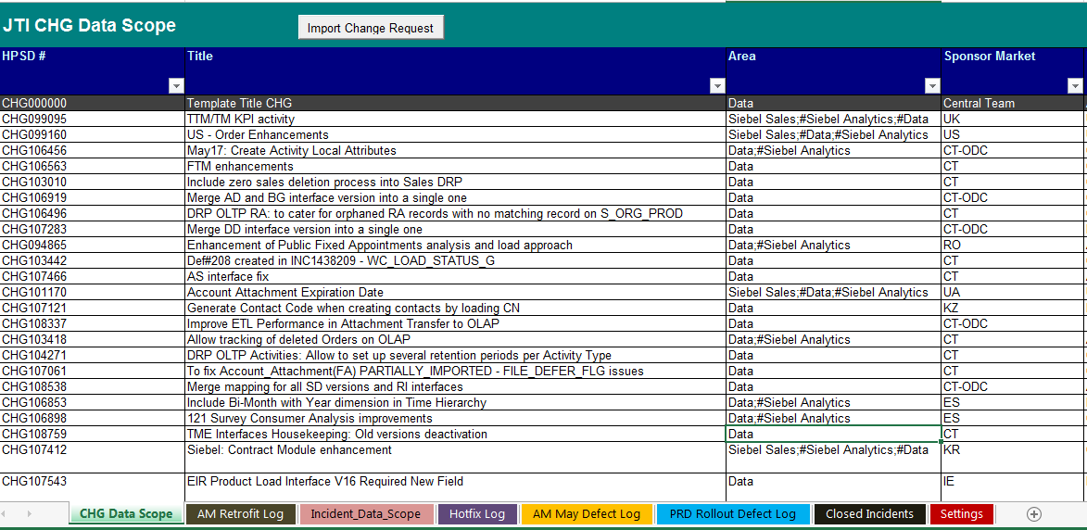
2. Updating Scope Sheet
2. 1 What to update?
The same scope sheet is used for changes requests, incidents, defects are all done
in the same scope sheet by choosing the required tab.
Select the required Tab that you want to update
The different category items for the data stream

Slide 16
2.2 Fields that should be updated
Important changes are tracked through scope sheet such as:
1. Responsible Perform for each stage – Analysis, Development, Peer Review
2. Technical Solution
3. MRU Target Release
4. Impacted Functionality
5. Data Update required
6. Complexity
7. Priority Data Update
Note: Incidents are normally assigned to Riteswaree when assigned to MRU team with the group TME-DATA-INTERFACES and change request to Robert

Slide 17
Next, the important fields that MUST be filled are:
EPM Assigned Person: who has worked on the incident.
Release Dependant (INC): If fix required should is release dependant.
Question: What do you understand by release dependant
Data Update Required: Y or N: Based on the fix to be done if any data update required as post task
Test Script Required: Y or N. Based on the fix done, a user test script must be provided.
Note: Applicable for release dependant incidents
Technical Solution in the format :
e.g. Change mapping to transfer AB values from OLTP to OLAP (understandable description)
MRU STATUS
MRU Comments in the format :
[20160621:RR] DEV currently in progress in MRU
Notes:
Add NRA when more than one resource has worked on INC or CHG or Defects

Slide 18
Updating Scope Sheet
Peer Review Name
Review date: The date that the peer review was done.
EPM Analysis/Development/Peer Review (PCS): Update to NRA when new resource added.

Slide 19


Updating Scope Sheet
Change Requests Impacted Fields
Name of person doing Analysis
Total man days estimated
Name of person doing development
Status of development
Y only if data update required
Name of person assigned for review
Description of current progress in the form: [20120621:LK] DEV in progress
Date
reviewed

Slide 20
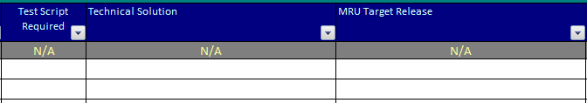
Updating Scope Sheet
Incidents Impacted Fields
Mandatory for all CR and Incidents
Description of technical solution that was done to resolve issue
When will it be release? Ex: UAT 1, UAT 2….

Slide 21
RELEASE DEPENDANT/ HOT FIX Incidents
All incidents that are hot-fixed or classified as release dependant, the
following processes must be followed:
Prepare a DTD and sent for ODC for validation.
Once DTD is approved, we proceed with development in DEV.
Prepare unit test script
Log Data Issue log, SVN and prepare data update and add to post release tasks if required
Review Incident and make user/Integration test script
Service Now and scope sheet update

Slide 22
3. SharePoint UPDATE
3. 1 Select tab to update
Link to SharePoint:
https://jvpngva.jti.com/sites/TME/Testing/Lists/May17%20Release%20Log/,DanaInfo=apps.jti.com+AllItems.aspx
The different stages of a CR are:
Analysis : For analysis & estimation period, i.e. . DTD preparation
Estimates Ready: Once DTD is ready for validation
Business Approval : ODC approves DTD and CR goes into DEV
Pending for Review : DEV completed and CR is ready to be reviewed
Ready in UAT: Both DEV and Peer review completed
Rejected: CR was rejected
More Info Needed: When FD is not clear or we require additional details from COE, we re-assign CR with appropriate description and set status to More Info Needed.

Slide 23
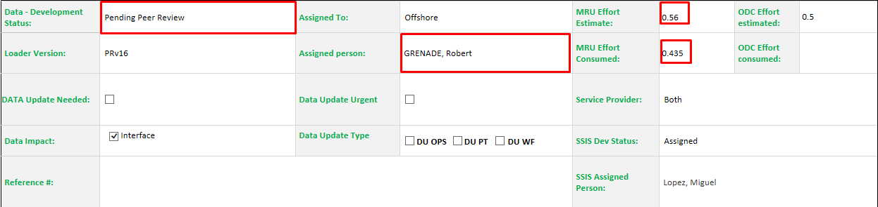
SharePoint UPDATE
WHEN?
On a daily basis.
WHAT to update?
Effort Estimated and Effort Consumed, Assigned person, Development Status, short description of current status.
Always assigned to Arnaud for MRU
Effort estimated as per analysis done

Slide 24
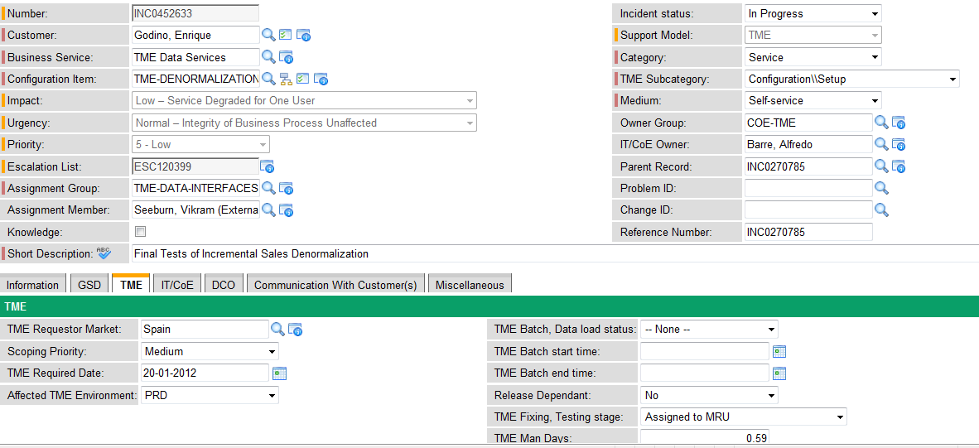
4. INCIDENT UPDATE
WHEN?
On a daily basis.
WHAT to update?
Once you start working on an incident, we update incident and change TME Fixing, Testing Stage to “Work in Progress in MRU”
By default should be set to No (Initially None)
Important field, should be updated accordingly

Slide 25
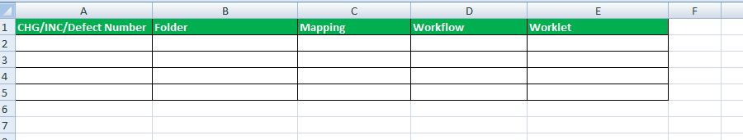
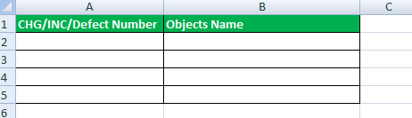
Update Impacted Object Document
This document need to be updated by the Developer of the Change
Request/Incident or Defect to include the impacted Object per change request.
You have several sections that need to be filled as follows:
INFORMATICA
IFB/ PHP/JAVA PARAMTER FILES ETC
Generic Entity

Slide 26
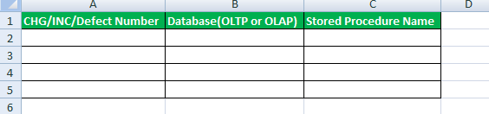
3. IFB/ PHP/JAVA PARAMTER FILES ETC
4. DB
5. Documents to be delivered on RD
Document Path:
J:\General\04_RELEASE_MANAGEMENT\2017-05_Release PROD MAY17\04_Release Docs\003-DataMAY_2017_Data_Impacted_Objects_v1.0

Slide 27
IMPORTANT LINKS
Service Now
https://jvpn.jti.com/,DanaInfo=jti.service-now.com,SSL+
Sharepoint
https://jvpngva.jti.com/sites/TME/Testing/Lists/May17%20Release%20Log/,DanaInfo=apps.j ti.com+AllItems.aspx
JTI Deliverables https://jvpngva.jti.com/sites/TME/it/Release%20Deliverables/Forms/,DanaInfo=apps.jti.com+AllItems.aspx
Process and Templates Documents
J:\General\04_RELEASE_MANAGEMENT\00_Process & Templates
Data Issue Log
https://mruperf/svn/svn_repos/Phase II/TME_Phase_2_AM/10_Data_Issue_Log
HLFD Documents
OLTP: https://mruperf/svn/svn_repos/Phase II/EIM/09 - Interface July IP14/HLFD-Final
OLAP:https://mruperf/svn/svn_repos/Phase II/ETL/03 - Documents/09 - FLAT FILE DEFINITIONS

Slide 28
Impacted Object Document
J:\General\04_RELEASE_MANAGEMENT\2017-05_Release PROD MAY17\04_Release Docs\ MAY_2017_Data_Impacted_Objects_v1.0.xlsx
DTD
J:\General\04_RELEASE_MANAGEMENT\00_Process & Templates\Data Detailed TD
Test Scripts
J:\General\04_RELEASE_MANAGEMENT\00_Process & Templates\Test Scripts\Data

Slide 29
QUESTIONS ?

